Slide 1
Recruitment & Selection
Cdr. Vijay Pratap Singh
Adjunct Professor, TCET
Notes:
This template can be used as a starter file for a photo album.

Slide 2
WHAT IS RECRUITMENT?
“Recruitment is the process of looking for prospective employees and stimulating and encouraging them to apply for the job.” – (Flippo EB,1980)
“Recruitment is a process to discover the sources of manpower to meet the requirements of the staffing schedule and to employ effective measures for attracting that manpower in adequate numbers to facilitate effective selection of an efficient working force.” -
(Yoder D, et al1972)

Slide 3
RECRUITMENT
Recruitment needs are of three types:
Planned: Arises from changes in the organization and retirement policy.
Unexpected: Arises on account of resignations, deaths, accidents and illness.
Anticipated: Refers to those movements in personnel which an organization can predict by studying trends in the internal and external environments.

Slide 4
RECRUITMENT GOALS
Attract the Qualified Applicants
Encourage Unqualified Applicants to self- select themselves out

Slide 5
Recruitment is a two way street
Organization looks for Qualified Applicants
Applicants look for Potential Placement Opportunities

Slide 6
A good recruitment policy
Complies with government policies
Provides job security
Provides the employees with opportunities for development and is flexible to accommodate changes
Ensures its employees long-term employment opportunities
Cost effective for the organization

Slide 7
RECRUITMENT PROCESS
CANDIDATE
ORGANIZATION
Receive Education and choose Occupation
Vacant or New position occurs
Acquire Employment Experience
Generate candidate pool via internal or external recruitment methods
Look for Job Openings
Evaluate Candidates via Selection process
Apply for jobs
Impress Company during Selection process
Impress Candidates
Evaluate Jobs and Companies
Make Offer
Accept or Reject Job Offers

Slide 8
Factors Governing Recruitment
INTERNAL FACTORS
Recruitment Policy of the Organization
Size of the organization & the Number of Employees
Cost Involved in Recruitment
Growth & Expansion Plans of the Organization
EXTERNAL FACTORS
Supply & Demand of Specific Skills in the Market
Political & Legal considerations such as Reservations
Company’s Perception by the Job Seekers

Slide 9
STRATEGIC RECRUITING DECISIONS
HR PLANNING DECISIONS
How Many Employees Needed
When Needed
KSAs Needed
Special Qualifications
STRATEGIC RECRUITING DECISIONS
Where to Recruit: Internal/External
Who to Recruit: Flexible Staffing Options
Nature of Job Requirements
DECISIONS ON RECRUITING SOURCES/METHODS
Advertising Choices
Recruiting Activities

Slide 10
STRATEGIC RECRUITMENT DECISIONS
1. REGULAR EMPLOYMENT: Regular employment consists of a continuous, predictable, and scheduled employment of six months' duration or longer. Regular employment may be full time or part time.
2. FULL-TIME OR PART-TIME: Full-time employment consists of a regular schedule of 37.5 hours per week. Part-time employment consists of a regular schedule of less than 37.5 hours per week.
3. INDEPENDENT CONTRACTORS: Perform specific services on a contractual basis used in a number of areas including, building maintenance, security, and advertising/public relations.

Slide 11
STRATEGIC RECRUITING DECISIONS
4. PROFESSIONAL EMPLOYER ORGANIZATIONS AND EMPLOYEE LEASING: An employer signs an agreement with an employee leasing company, after which the existing staff is hired by the leasing firm and leased back to the company for a fee. A small business owner turns his or her staff over to the leasing company, which then writes the paychecks, pays the taxes, prepares and implements HR policies, and keeps all the required records.
5. TEMPORARY WORKERS : This is based on “try before you buy” approach . Employers who use temporary employees can hire their own temporary staff or use agencies supplying temporary workers. Such firms supply workers on a rate-per-day or per-week basis.
6. SEASONAL EMPLOYEES : Seasonal employees are hired to work on a part-time basis by companies that need extra help during a particular season, typically the Christmas season or crops harvesting.

Slide 12
SOURCES OF RECRUITMENT
INTERNAL SOURCES
EXTERNAL SOURCES

Slide 13
Internal Sources
Internal Recruiting Data base
Promotions and Transfers
Job Posting & Bidding
Re-recruiting former Employees & Applicants

Slide 14
ADVANTAGES
Better morale of Promotee
Better assessment of abilities
Lower cost for some jobs
Motivator for good performance
Causes a succession of promotions
Have to hire only at entry level
DISADVANTAGES
Inbreeding
Possible morale problems of those not promoted
“Political” infighting for promotions
Need for management- Development program

Slide 15
External Sources
1) PRESS ADVERTISEMENTS
-Advertisements of the vacancy in newspapers and journals.
2) EDUCATIONAL INSTITUTES
-Campus recruitment.
3) PLACEMENT AGENCIES
-Private consultancy firms.
-Known as RPO(Recruitment Process Outsourcing).

Slide 16
4) EMPLOYMENT EXCHANGES
-Provide job information to job seekers
-Help employers in identifying suitable candidates.
5) LABOUR CONTRACTORS
-Manual workers can be recruited through contractors.
6) UNSOLICITED APPLICANTS
-Many job seekers visit the office of well-known companies on their own.
7) EMPLOYEE REFERRALS / RECOMMENDATIONS
-Current employees of the organization can refer their friends and relatives for some position in their organization.

Slide 17
ADVANTAGES
New “blood” brings new perspectives
Cheaper and faster than training Professionals
No group of political supporters in company
Organization ready
DISADVANTAGES
May not select someone who will “fit” the job or organization
May cause morale problems for internal
Candidates not selected
Longer “adjustment” time

Slide 18
INTERNET RECRUITING METHODS
E- Recruitment
Internet as a source of recruitment.
The job seekers send their applications or curriculum vitae i.e. CV through e mail.
Alternatively, job seekers place their CV’s in worldwide web.
Example
1. Job Boards
2. Employer Web Sites

Slide 19
ADVANTAGES
Cost savings
Time savings
Expanded pool of applicants
DISADVANTAGES
More unqualified applicants
Additional work for HR staff members
Many applicants are not seriously seeking employment
Access limited or unavailable to some applicants

Slide 20
OUTSOURCING
A company may draw required personnel from outsourcing firms.
The outsourcing firms conducts the initial screening of the candidates according to the needs of the organization.
In turn, the outsourcing firms charge the organizations for their services.

Slide 21
Advantages of Outsourcing
Company need not plan for human resources much in advance.
Value creation, operational flexibility and competitive advantage.
Company is free from salary negotiations, weeding the unsuitable resumes/candidates.
Company can save a lot of its resources and time

Slide 22
IMPORTANCE OF RECRUITMENT
Provides organization with a pool of qualified candidates
The more qualified the pool the better the success rate in selection
Can help the organization meet affirmative action goals
Can increase organizational effectiveness

Slide 23
CONSTRAINTS ON RECRUITMENT
Image of the Company
Attractiveness of Job
Internal Organizational Policy
Recruitment Cost

Slide 24
SELECTION
Selection is the process of picking up individuals (out of the pool of job applicants) with requisite qualifications and competence to fill jobs in the organization. A formal definition of Selection is:
“Selection is the process of differentiating between applicants in order to identify and hire those with a greater likelihood of success in a job.”

Slide 25
DIFFERENCE BETWEEN RECRUITMENT AND SELECTION
Recruitment | Selection
1. Recruitment refers to the process of identifying and encouraging prospective employees to apply for jobs. 2. Recruitment is a positive process because it involves looking for prospective employees and convincing them to apply for the job. Here, the company is making all candidates apply for the job, hence it is a positive action. | 1. Selection is concerned with picking up the right candidates from a pool of applicants. 2. Selection on the other hand is negative in its application in as much as it seeks to eliminate as many unqualified applicants as possible in order to identify the right candidates.

Slide 26
PROCESS / STEPS IN SELECTION
1. Job Analysis: The first step in selection process is analysing the job. Job analysis consists of two parts:
(a) Job Description, and
(b) Job Specification.
Proper job analysis helps to advertise the job properly. Accordingly, the right candidates may apply for the job, thus saving a lot of time and effort of the selectors.
2. Advertising the Job: The next step is to advertise the job. The job can be advertised through various media. The right details about the job and the candidate must be given in the advertisement.
3. Initial Screening: The initial screening can be done of the applications and of the applicant. Usually, a junior executive does the screening work. At this stage, the executive may check on the general personality, age, qualifications, family background of the candidate. The candidate may also be informed of salary, working conditions, etc.

Slide 27
4. Application Form: It is a prescribed form of the company which helps to obtain information about candidate with respect to social, biographic, academic, work experience, references, etc.
5. Tests: Various tests are conducted to judge the ability and efficiency of the candidates. The type of tests depends upon the nature of job. An important advantage of testing is that it can be administered to a large group of candidates at a time and saves time and cost.
The various tests are: (a) Personality test, (b) Intelligence test, (c) Performance test, (d) Stress test, etc.
6. Interview: It is face to face exchange of views, ideas and opinions between the candidate and interviewer(s). There are various types of interviews such as: (a) Panel Interview, (b) Individual Interview, (c) Group Interview, (d) Stress Interview, (e) Exit Interview.

Slide 28
7. Reference Check: A candidate may be asked to provide references from those who are willing to supply or confirm about the applicant’s past life, character and experience. Reference check helps to know the personal character and family background of the candidate.
8. Medical Check: Medical examination of the candidates is undertaken before they join the firm in order to – Find out whether the candidate is physically fit to carry out duties and responsibilities effectively,
9. Final Interview: Before making a job offer, the candidates may be subjected to one more oral interview to find out their interest in the job and their expectations. At this stage, salary and other perks may be negotiated.
10. Job Offer: This is the most crucial and final step in selection process. A wrong selection of a candidate may make the company to suffer for a good number of years and the loss is incalculable. Company should make a very important decision to offer right job to the right person.

Slide 29
Importance of selection
Reduce Applicant Numbers Recruitment attracts many applicants to a particular job, which may prove difficult to manage, but selection reduces applicants to a manageable number. Candidates who have applied for a job during the recruitment stage are screened in the selection stage. Those who prove suitable for the job are selected, and unsuitable ones are rejected.
Assess Behaviour Selection gives managers an opportunity to assess potential employees' character and personality. This ensures that only an employee with the most suitable personalities and skills is given the job. The organization takes particular notice of the personal flexibility and adaptability of a candidate, which assures that such an individual can adjust rapidly to the tough demands of the job.

Slide 30
Low Employee Turnover Appropriate selection procedures applied in the recruitment process ensure that only the most qualified individual is chosen to fill a vacancy. Recruited employees who are satisfied with their jobs lead to a low employee turnover rate. Employee retention is important to an organization, as the costs of hiring and training new employees are very high.
The Time Dimension A good selection procedure saves time in the recruitment and orientation processes because the applicant is expected to have been introduced to some aspects of the organizational culture, such as the dress code. No time is wasted trying to inculcate the new recruit with various aspects of the organization's culture and norms. The employee is given an adequate picture of what the new job entails, thus eliminating wasting time doing unnecessary chores that are not part of his job description.

Slide 31
Why selection is called negative process?
Selection is called a negative process in Business as more candidates who apply for employment are rejected than employed. That is why Selection is called a negative process.

Slide 32
Interview in selection
Pre-screen Your preliminary interview with a recruiter will likely be via telephone. After you submit your application or resume, a recruiter pre-screens you and other applicants to identify those with the requisite qualifications. Often, recruiters give you advance notice, so you'll have time to prepare for the interview, which should last approximately 20 minutes. During the scheduling call, the recruiter might ask if you're still interested in the job to ensure he makes best use of his time in this stage of the process.
Telephone Interview Phone interviews typically start with the recruiter giving a basic job description, followed by a few questions about your work history and qualifications. Some recruiters ask about your current or desired salary. Salary questions are useful in narrowing the candidate field. If you're flexible on compensation and benefits, you could say, "Based on my research and what I've learned about this job, my salary requirements are consistent with the current market. I'm confident that when the time comes to talk about salary, we can arrive at a mutually agreeable number."

Slide 33
Face-to-Face Interview
If you impress the recruiter during your phone interview, she might schedule you for a face-to-face interview before the end of the phone interview. However, if she wants to evaluate your responses against those of other applicants, she might give you a date on which she'll tell you whether you're selected for the next round. If she doesn't explain the selection process, ask about it during the phone interview.
Qualifying Questions Face-to-face interviews are your opportunity to shine. The questions will be more substantive than the first-round telephone interview, giving you a chance to prove that you're a viable candidate. The interviewer -- the recruiter or hiring manager -- will ask behavioural and situational interview questions.

Slide 34
Evaluation If you're interviewing face-to-face with the hiring manager, she is probably assessing your qualifications and how well you'd fit in the organizational culture. Interview questions test your knowledge and fitness for the position, whether you are qualified to do the work or if you have the aptitude for it.
Selection The final stage in the selection process usually is a brief conversation wherein the company makes a verbal offer. This could be via telephone, e-mail or, if you are a remarkable candidate, at the end of your face-to-face interview. You can verbally accept the offer if you're sure about your decision; however, you'll probably receive a written offer that contains the job details, salary, benefits summary and start date. Once the company makes its selection, it moves forward with the vetting process or the pre-employment steps, such as a background check and drug screen.

Slide 35
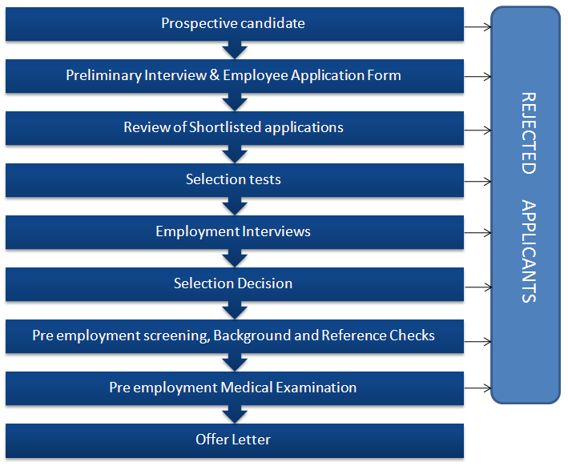

Slide 36
SELECTION METHOD
The Three most Common Methods used are:
1. Testing
2. Gathering Information
3. Interviewing

Slide 37

1. TESTING
Tests measure knowledge, skill, and ability, as well as other characteristics, such as personality traits.
TESTING TYPES
Cognitive Ability Test
Personality Test
Physical Ability Test
Integrity Test
Drug Test
Work Sample Testing

Slide 38
1. Cognitive Ability Testing
It measures the learning, understanding, and ability to solve problems. e.g. Intelligence Tests.
2. Physical Ability Testing
It assesses muscular strength, cardiovascular endurance, and coordination.
TESTING
TYPES
3. Personality Testing
It measures the patterns of thought, emotion, and behavior. e.g. Myers Briggs

Slide 39
4. Integrity Testing
6. Drug Testing
It is designed to assess the likelihood that applicants will be dishonest or engage in illegal activity.
Normally requires applicants to provide required sample that is tested for illegal substances.
TESTING
TYPES
5. Work Sample Testing
Measures performance on some element of the job.

Slide 40
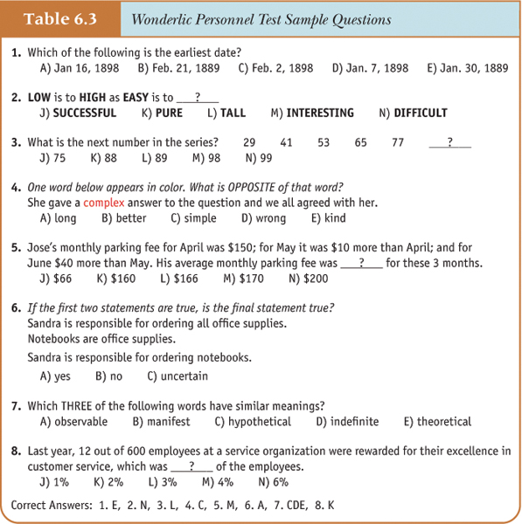
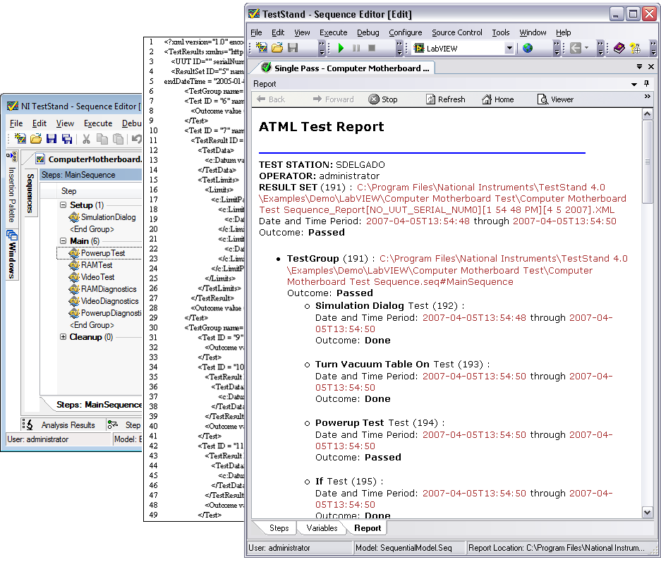
TEST
SAMPLE

Slide 41

2. INFORMATION GATHERING
Common methods for gathering information include application forms and résumés, biographical data, and reference checking.

Slide 42
Application Forms and Résumés
Generally ask for information such as address and phone number, education, work experience, and special training.
At the professional-level, similar information is generally presented in résumés.
Biographical
Data
Historical events that have shaped a person’s behavior and identity.
Reference Checking
Involves contacting an applicant’s previous employers, teachers, or friends to learn more about the applicant Issues with reference checking

Slide 43
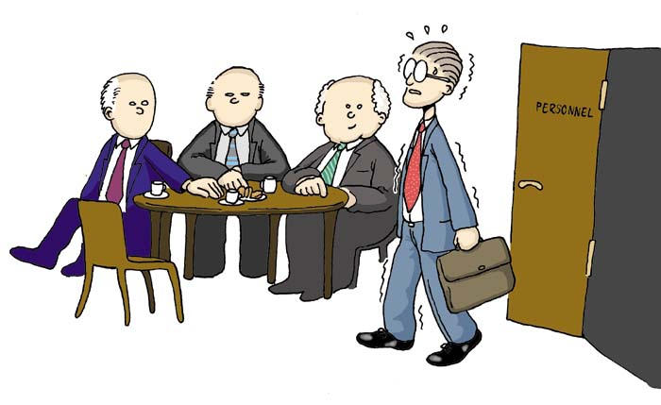
3. INTERVIEWS
The interview is the most frequently used selection method.
Interviewing occurs when applicants respond to questions posed by a manager or some other organizational representative (interviewer).
Typical areas in which questions are posed include education, experience, knowledge of job procedures, mental ability, personality, communication ability, social skills.

Slide 44
45
Situational Interview
1. Structured Interviews
Behavioral Interview
Types of Interviews
2. Unstructured Interviews

Slide 45
1. Structured
Interviews
2. Unstructured
Interviews
46
Uses a list of predetermined questions. All applicants are asked the same set questions. There are two types of structured interviews.
Interviews-open ended questions are used such as “Tell me about yourself”
SITUATIONAL INTERVIEW
In which the interviewer asks questions about what the applicant would do in a hypothetical situation
BEHAVIORAL INTERVIEW
In which the questions focus on the applicant’s behavior in past situations.
This allows the interviewer to probe and pose different sets of questions to different applicants.

Slide 46
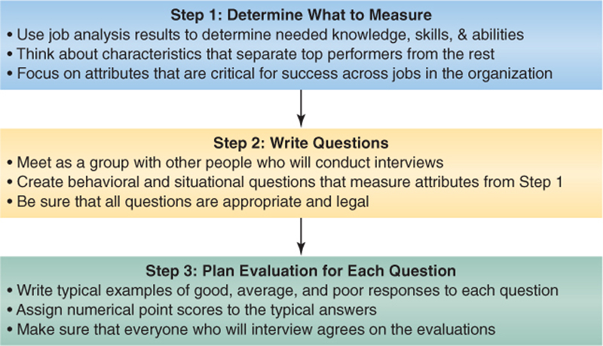
CREATING STRUCTURED INTERVIEW QUESTIONS
47

Slide 47
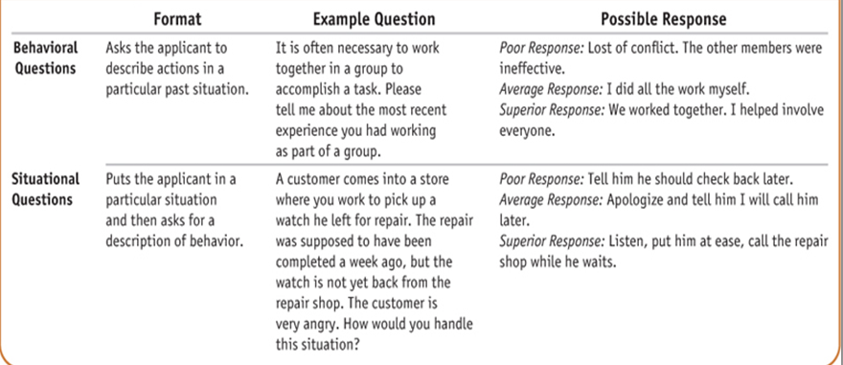
INTERVIEW QUESTION

Slide 48
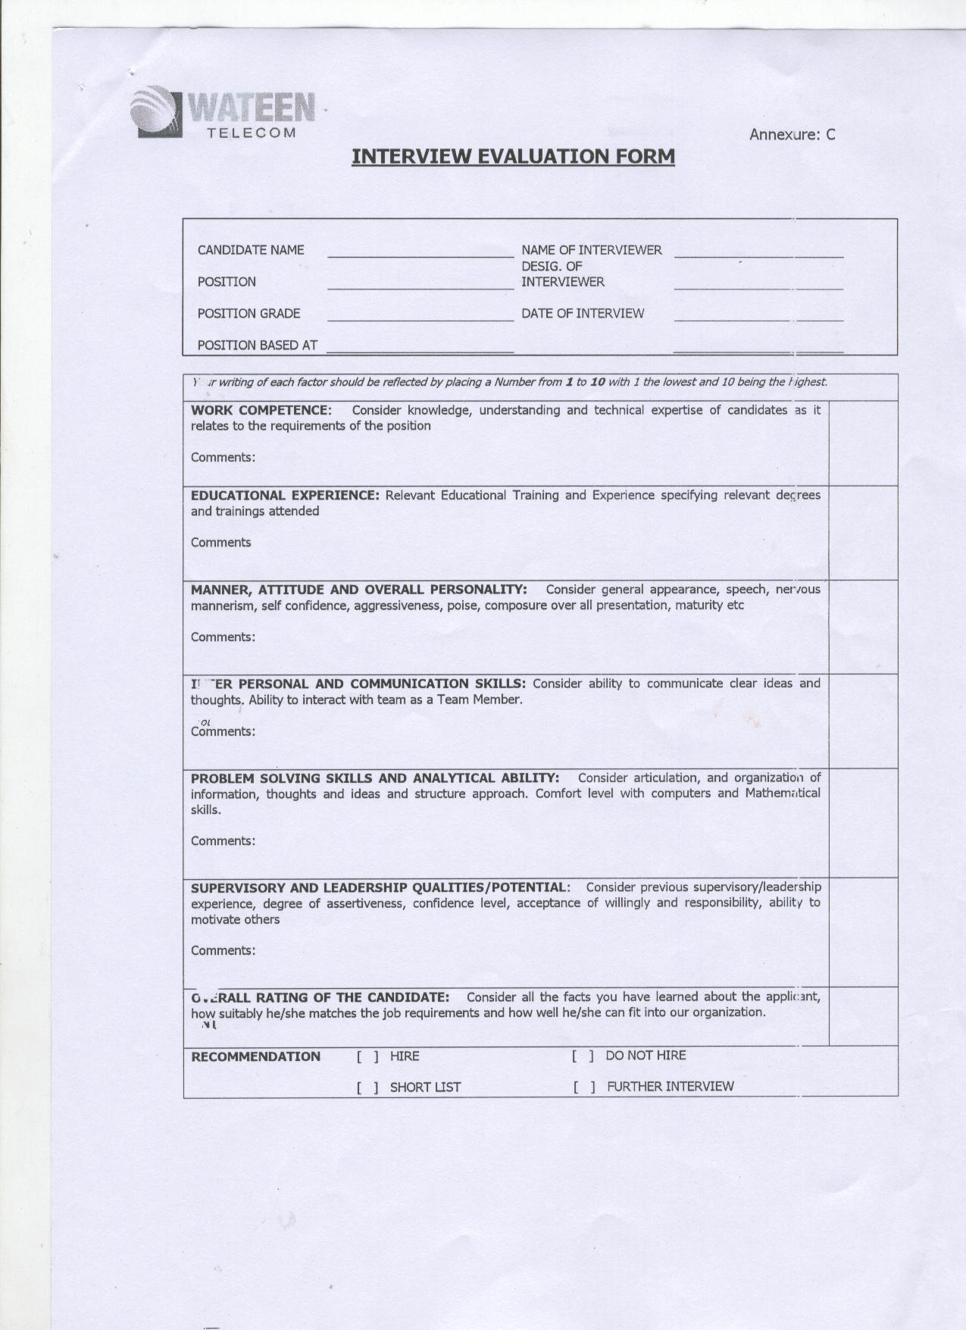
INTERVIEW EVALUATION FORM
WATEEN TELECOM

Slide 49
THOUGHT FOR THE DAY
“If an HR person is trying to choose people for an organization, knowing their values are very important-if they are not consistent with the organization’s values they are not likely to stay very long.”
Professor, Roger Collins.

Slide 50


